Slide 1
E-retail factors for customer activation and retention: A case study from Indian e-commerce customers
Customer satisfaction has emerged as one of the most important factors that guarantee the success of online store; it has been posited as a key stimulant of purchase, repurchase intentions and customer loyalty. A comprehensive review of the literature, theories and models have been carried out to propose the models for customer activation and customer retention. Five major factors that contributed to the success of an e-commerce store have been identified as: service quality, system quality, information quality, trust and net benefit. The research furthermore investigated the factors that influence the online customers repeat purchase intention. The combination of both utilitarian value and hedonistic values are needed to affect the repeat purchase intention (loyalty) positively. The data is collected from the Indian online shoppers. Results indicate the e-retail success factors, which are very much critical for customer satisfaction.

Slide 2
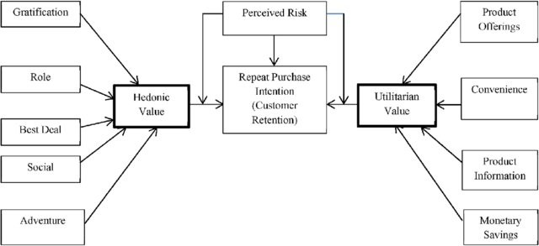

Slide 3
Problem Statement:
Customer retention
The customer retention is the process of engaging existing customers to continue buying products or services from the business.
Customer satisfaction
Customer satisfaction is a measurement that determines how happy customers are with a company’s products, services, and capabilities. Customer satisfaction information, including surveys and ratings, can help a company determine how to best improve or changes its products and services.
E-retail success.
How many happy customers does the particular e-retail website have.
Data Analysis.
Need to perform analysis on the data that has been provided and according to EDA, Visualization and other analysis, need to conclude the findings from analysis.

Slide 4
Understanding:
There are 2 excel sheets in the dataset that has been shared.
First, excel sheet is the detailed data of the e-retail website.
Second, excel sheet is the encoded data of the e-retail websites.
There are information of customers who do shopping online from different websites.
The information can be good as well as bad feedback for e-retail websites.
There are so many questions, polls and feedback columns in our dataset.
There are feedbacks & customer reviews of e-retail website such as:
Amazon.in
Flipkart.com
Myntra.com
Paytm.com and more.

Slide 5
Data Inspection
**df1**
RangeIndex: 269 entries, 0 to 268
Data columns (total 71 columns): 1 (int64) , 70 (object)
# Change dtype of the pin code question to object type
Code: df.iloc[:,3]=df.iloc[:,3].astype('object’)
There are 166 duplicated records
Shape after removing duplicates: (103,71)
Dropping pin code question : (103,70)
**df2**
Same data preprocessing done on df1
Shape of df2: (139,70)

Slide 6
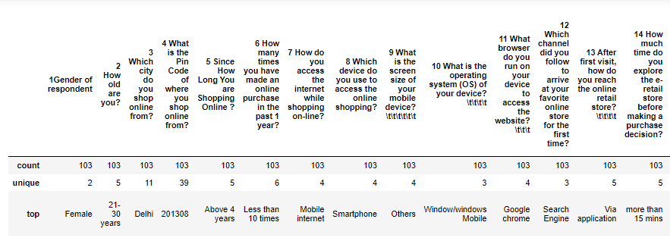
Descriptive Statistic:
First Dataset:

Slide 7
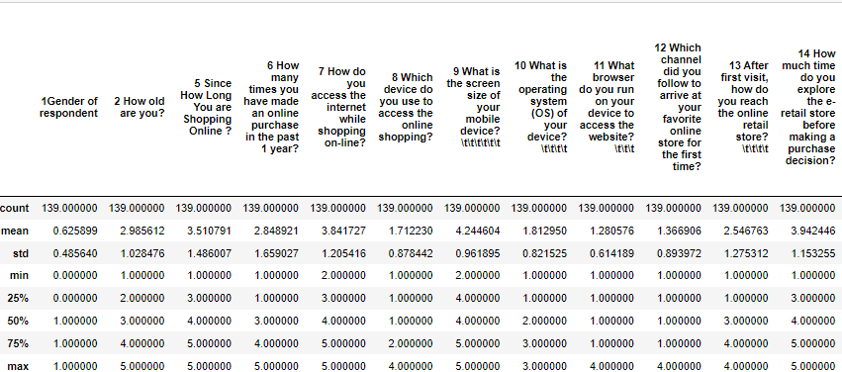
Second dataset:

Slide 8
EDA

Slide 9
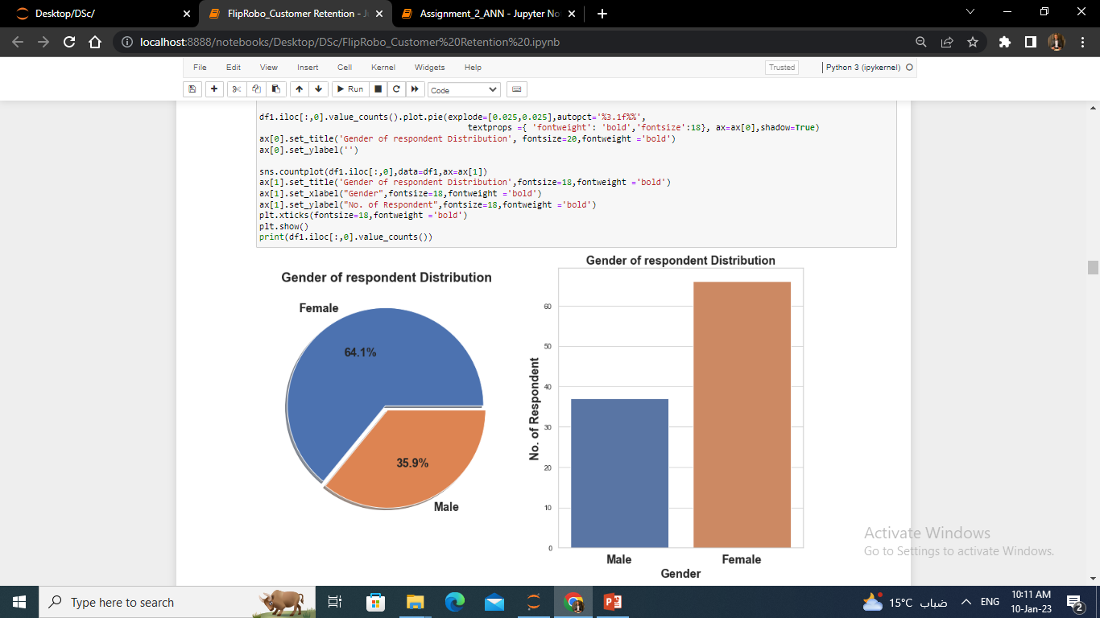
Female Customers are more than Male customer.

Slide 10
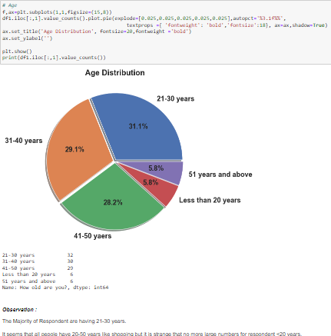

Slide 11
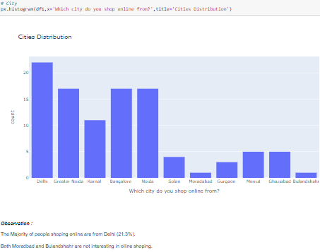

Slide 12
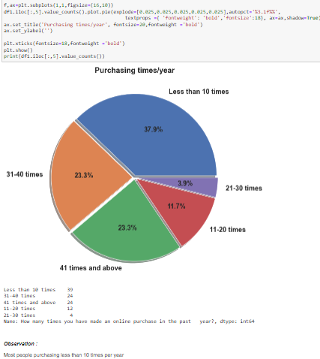

Slide 13
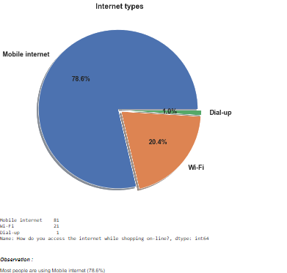

Slide 14
POLL

Slide 15
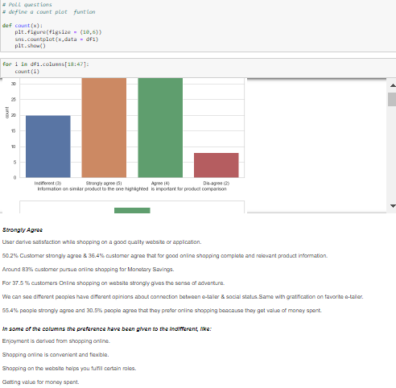

Slide 16
Strongly agree/Agree/Disagree/Strongly disagree/Indifferent Poll.
Strongly agree/Agree, can be considered as Agreed.
Disagree/Strongly disagree, can be considered as Disagree.
* All the columns in previous 2 slides are like the poll columns for the customers, where they have to agree or disagree with the question of poll with their own experience on website they shop at ... *
Most of the customers are agreed with the question and giving their opinions on the website.
There are very less number of customers who have voted for disagreed the conditions or question.
- In some of the columns the preference have been given to the Indifferent, like:
Shopping on your preferred e-tailer enhances your social status.
You feel gratification shopping on your favorite e-tailer.
Shopping on the website helps you fulfill certain roles.

Slide 17
Postive Feedback:
'From the following, tick any (or all) of the online retailers you have shopped from; ', 'Easy to use website or application', 'Visual appealing web-page layout', 'Wild variety of product on offer', 'Complete, relevant description information of products', 'Fast loading website speed of website and application', 'Reliability of the website or application', 'Quickness to complete purchase', 'Availability of several payment options', 'Speedy order delivery ', 'Privacy of customers’ information', 'Security of customer financial information', 'Perceived Trustworthiness', 'Presence of online assistance through multi-channel'

Slide 18
Negative Feedback:
'Longer time to get logged in (promotion, sales period)', 'Longer time in displaying graphics and photos (promotion, sales period)', 'Late declaration of price (promotion, sales period)', 'Longer page loading time (promotion, sales period)', 'Limited mode of payment on most products (promotion, sales period)', 'Longer delivery period', 'Change in website/Application design', 'Frequent disruption when moving from one page to another'

Slide 19
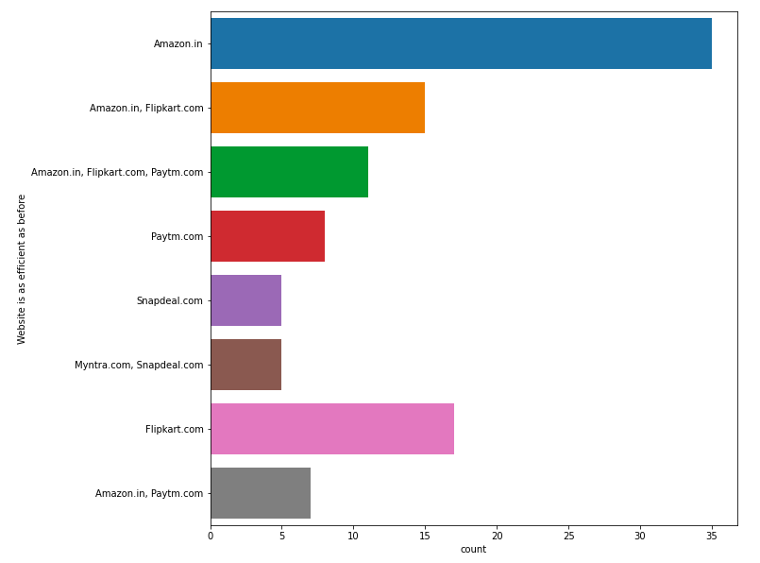
Website is as efficient as before
Positive for Website,
Amazon is still on the top and after that flipkart is there.

Slide 20
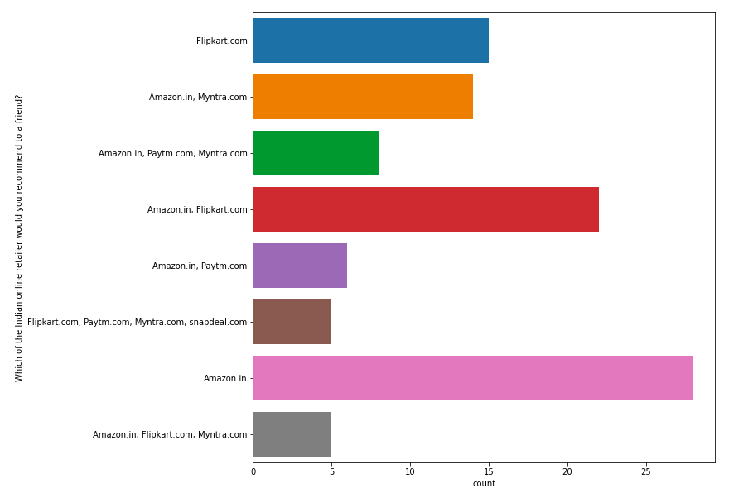
Which of the Indian online retailer would you recommend to a friend?
Amazon.in is the most recommended website, among all other website.
Myntra.com & Flipkart.com, are on the 2nd in recommendation

Slide 21
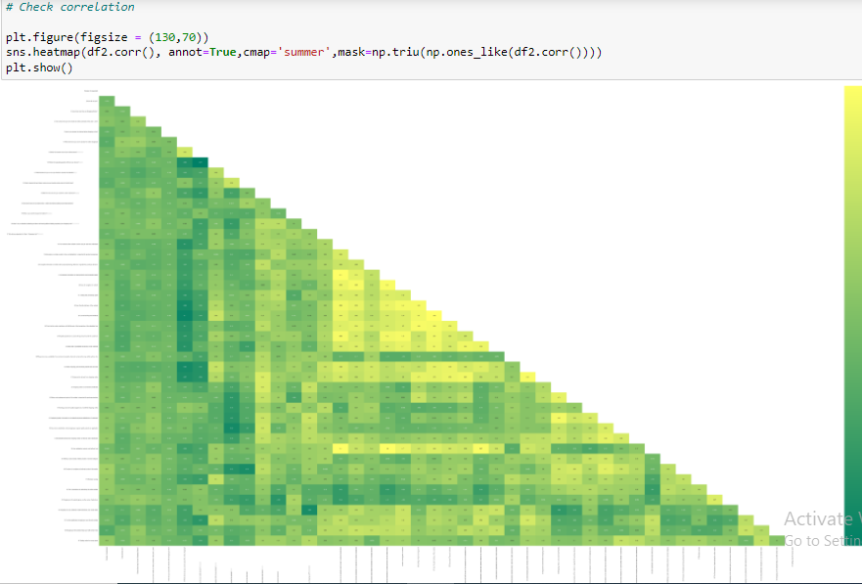
There are multicollinearity problem present in our dataset. Most of the columns are correlated with each other.

Slide 22
Normal Distribution & Outliers.
Almost all the columns are categorical columns as they are encoded ones. So we will be getting these kind of plots.

